Slide 1

It adventure: fAMILYgrocer executive presentation group 1: Ibrahim akinteye / moiz badr / veronika bikova / rob Brodofske

Slide 2

Operational (1): Most important it regulations How to tackle?
Key Regulations:
GDPR: Essential for EU market entry and avoiding fines.
PIPEDA: Protects data and reputation in Canada.
SOX & PCI-DSS: Boosts investor trust and company reputation.
Recommended Approach:
Define governance roles.
Identify key assets and risks.
Apply data protection measures.
Monitor compliance regularly.
Train employees on compliance.

Slide 3

Operational (2): completion of sap implementation; Asia, latin america?
Asia:
Adapt to local business practices and regulatory requirements.
Customize workflows, financial reporting, and SAP interfaces for cultural relevance.
Ensure compliance with data privacy laws and integrate with regional payment systems.
Provide multilingual support and tailored training for varying tech literacy levels.
Latin America:
Align SAP with country-specific tax and labor regulations.
Invest in IT infrastructure upgrades for performance in diverse settings.
Address connectivity challenges and integrate with regional supply chain systems.
Foster local stakeholder engagement and culturally relevant training.
Desired Outcome: Smooth Rollout of SAP in a secure environment

Slide 4

Operational (3): IT Controls in Latin America?
Access Controls:
Implement Identity and Access Management (IAM) systems.
Address critical gaps in Mexico and Brazil as flagged by auditors.
IT Governance:
Appoint a regional IT Head for compliance and standardized control enforcement.
Ensure stronger oversight to prevent future breaches.
Security Audits & Training:
Conduct regular independent audits to monitor controls.
Train employees on IT policies and secure practices to build awareness.
Centralized Monitoring:
Establish a Security Operations Center (SOC) for Latin America.
Use centralized logging to detect and respond to threats effectively.
Notes:
Based on FamilyGrocer’s history of a significant data breach in Latin America and auditor concerns about the lack of access controls in Mexico and Brazil, the following recommendations are critical:
Deploy access control mechanisms - Introduce identity and access management (IAM) systems to enforce strong access controls. This will address the external auditor's concern that “access controls are close to inexistent” in Mexico and Brazil.
Establish a regional IT governance structure - Appoint a regional IT Head to ensure local compliance, enforce standardized controls and implement global policies effectively. This ensures stronger oversight, which was previously absent during the data breach incident.
Conduct regular security audits and training - Perform frequent independent audits to monitor internal control effectiveness. Provide employee training to build awareness of IT policies and secure practices, particularly where resistance to change exists.
Centralize monitoring via a SOC - Enhance threat detection and response capabilities by implementing a centralized Security Operations Center (SOC) for Latin America. Implement centralized logging and monitoring tools to detect unauthorized access.

Slide 5
Operational (4): What To do with the crm?
Terminate Salesforce Contract
Given the limited scope, end deployment and absorb financial losses.
Lower IT Risk with Simplified Foundation
Well managed & low complexity foundation reduces availability and access risks.
Standardize on SAP
Reduce data accuracy & redundancy risks, improving data driven decision making for Big Data/Analytics.
Organizational Change Management Program
Increase adoption across Asia & Latin America
Assist CMO transition from Salesforce to SAP
Notes:
Industry research shows that organizations with well-managed, simplified foundations face significantly lower IT risk. FamilyGrocer should terminate the Salesforce.com CRM contract and standardize on the SAP HANA CRM platform to strengthen their foundation and reduce risks. This will also increase agility for expansion and acquisitions by reducing integration complexity and the associated risks with multiple CRM or ERP systems.
The organization should implement targeted change management programs in Asia and Latin America to address adoption issues as well as assisting the CMO rapidly move between CRM systems.

Slide 6

Operational (5): IT Controls – cloud based services?
Access & Security:
Implement MFA, RBAC, and data encryption.
Compliance & Risk:
Audit vendors, enforce SLAs, and control third-party access.
Monitoring & Response:
Use SIEM tools, review logs, and plan for incidents.
Operational Efficiency:
Manage changes, ensure secure configurations, and enable data portability.
Resilience & Training:
Integrate disaster recovery plans and train staff on cloud security.
Desired Outcomes: Secure, compliant, and scalable cloud operations.

Slide 7
Operational (6): How to Deal with the requirements from the Desktop Software Vendor?
Vendor Management Program
Develop comprehensive vendor management governance program to address contracts, legal, compliance, financial risks.
Establish Enterprise Agreement (EA)
Establish Enterprise Agreement with this vendor.
Offers licensing flexibility, scalability, auditing, and true-up, managing & mitigating the risk.
Clear Roles & Responsibilities
Through vendor management program governance, establish RACI for licensing & contract management. Train accordingly.
Notes:
Adventure IT recommends that FamilyGrocer develop a robust vendor management program to address operational, financial, legal, and compliance risks, including clear policies for onboarding, selection, and monitoring vendors.
Repairing the relationship with the current vendor and establishing an Enterprise Agreement (EA) should be a priority to provide flexibility in licensing, ensure compliance, and lower agility risks.
Once the EA is in place, FamilyGrocer should implement policies, assign clear responsibilities, and conduct annual audits supported by training programs to significantly reduce risk exposure across the organization.

Slide 8

Strategic (1a): innovation/expansion recommendations: drone delivery
KEY RISKS
Data & Privacy: Use of Drones raises concerns about privacy and compliance.
Regulatory: Complex airspace and aviation regulations challenge implementation.
Safety & Liability: Risk of collisions or failures could lead to injury, lawsuits, and public backlash.
Reputational: Safety issues may trigger cascading risks, damaging the brand.
RECOMMENDATIONS: PROCEED CAUTIOUSLY
Project aligns with organization’s risk appetite but may exceed risk tolerance.
Start with a small-scale pilot project to test feasibility and minimize initial exposure.
Explore partnerships or acquisitions with established drone operators for faster, safer implementation.
Notes:
When it comes to drone delivery there are a number of associated risks.
Data & Privacy: Use of Drones raises concerns about privacy and compliance.
Regulatory: Complex airspace and aviation regulations challenge implementation.
Safety & Liability: Risk of collisions or failures could lead to injury, lawsuits, and public backlash.
Reputational: Safety issues may trigger cascading risks, damaging the brand.
However, the Board and Executives indicated a high risk appetite, but be cautious of this one exceeding risk tolerance.
Our recommendation is to proceed cautiously with a small pilot project and explore partnerships or acquisitions with established players to minimize risk exposure.

Slide 9

Strategic (1b): innovation/expansion recommendations: IOT ENABLEMENT
KEY RISKS
Technological Risks: System failure and data integrity issues.
Cybersecurity Risks: Vulnerabilities in IoT networks.
Compliance Risks: Be aware of customer data usage.
RECOMMENDATIONS: GO FOR IT!
Partner with reliable vendors aligned with FamilyGrocer’s risk management practices.
Design a robust cybersecurity framework and resilient IoT network architecture.
Implement staff training, change management programs, and KPIs to measure efficiency and system effectiveness.
Notes:
After analyzing the possibility of implementing sensors to enable an IoT model for Inventories in North America, although there are some risks, we believe they are manageable.
Risks include technology risks, cybersecurity risks, and potentially some compliance risk depending on data usage.
Our recommendation is to proceed with this project and considering the following strategies:
Pay particular attention to third party risk and Partnering with reliable vendors that have solid risk management practices.
Pay particular attention to security by design when architecting a resilient IoT infrastructure
Add a light weight change management program for the people affected and to minimize risk associated with changes, and continuously monitor the program

Slide 10

Strategic (1C): innovation/expansion recommendations: web-based grocery
OPPORTUNITY
Web-based grocery store allows FamilyGrocer to tap into growing demand for online shopping, providing customers convenience and flexibility in their purchases. It also creates opportunities to expand market presence and gather valuable data to enhance the big data & analytics project.
RECOMMENDATIONS: GO FOR IT!
Ensure Data Protection
Safeguard sensitive customer information
Conduct regular security audits and vulnerability assessments.
Pay close attention to payment processing requirements (PCI-DSS)
Train employees and customers on Security, especially phishing prevention and strong password use.

Slide 11

Strategic (1D): innovation/expansion recommendations: SOCIAL MEDIA
OPPORTUNITIES:
Engage customers with real-time interactions and boost brand visibility.
Drive traffic to web grocery stores and increase sales through e-commerce integration.
Use data and influencer content to enhance strategies and build credibility.
RECOMMENDATIONS: #GO FOR IT!
Ensure compliance with data privacy regulations (GDPR, PIPEDA).
Manage platforms effectively to avoid inconsistent messaging.
Address negative feedback and maintain engaging, consistent content.

Slide 12

Strategic (1E): innovation/expansion recommendations: ANALYTICS
OPPORTUNITIES:
Improved Decision-Making: Analyze risk exposure to make informed credit, operational, and strategic decisions.
Proactive Risk Identification: Use predictive analytics to detect emerging risks (e.g., supply chain issues, cybersecurity threats).
Operational Efficiency: Identify root causes of inefficiencies and implement corrective actions.
KEY BENEFITS:
Data backed strategic decision making
Resilience: Real-time monitoring strengthens agility and preparedness.
Prevention: Develop contingency plans to mitigate risks before they escalate.

Slide 13

Strategic (1f): innovation/expansion recommendations: pharmacy acquisition
KEY OPPORTUNITIES
Leverage the mature IT Internal Controls system as a model to enhance FamilyGrocer's IT controls and address deficiencies across regions.
Align the pharmacy chain’s IT practices with FamilyGrocer’s SAP deployment for streamlined operations and improved compliance.
RECOMMENDATIONS: SIEZE OPPORTUNITIES
Analyze and implement scalable aspects of the pharmacy chain’s IT controls to address regional challenges.
Appoint the pharmacy chain’s CISO/CIO to fill the vacant IT Head role in Mexico, focus on Latin America (Mexico & Brazil)
Notes:
For the Pharmacy Chain Acquisition:
We believe this is an excellent opportunity to leverage the mature IT control systems model to address deficiencies across regions.
As the chain also utilizes SAP, integration and onboarding can be streamlines, and adopting certain IT controls will improve compliance.
Key recommendations including:
Appoint the pharmacy chain’s CISO or CIO to fill vacant role in Mexico. Immediately start addressing IT control deficiencies in Latin America, focusing on Mexico and Brazil.

Slide 14

Strategic (2): FULL OUTSOURCING OF IT DEPT?
RECOMMENDATIONS: KEEP CRITICAL, OUTSOURCE TRIVIAL
Strategic Oversight: Retain IT governance and critical functions to support analytics and expansion goals.
Risk Management: Reduce dependency on vendors and maintain internal control over cybersecurity.
Cost Efficiency: Outsource non-core tasks (e.g., infrastructure, help desk) to lower costs while focusing on innovation.
RISKS OF FULL OUTSOURCING
Loss of control over strategic IT functions.
Increased dependence on third parties for critical operations.
Management of Vendor - Performance
Goal: Balance external expertise with internal control to support growth and innovation.
Notes:
FamilyGrocer should not fully outsource its IT function. Instead, a hybrid model is recommended – retaining critical IT functions in-house while outsourcing non-core functions to strategic partners, as this aligns with FamilyGrocer’s strategic priorities and risk management requirements. The rationale for this position are:
Strategic Oversight Requirements - Given FamilyGrocer’s reliance on IT for Big Data and analytics initiatives, it is crucial to retain control over IT governance and strategic functions. The board's mandate for a roadmap to ensure IT supports expansion plans highlights the importance of keeping critical IT functions in-house.
Risk Management and Compliance - Full outsourcing increases dependency on vendors, as highlighted by the lack of vendor management practices and the Salesforce licensing issue. Retaining IT Risk Management and cybersecurity internally will mitigate these risks.
Cost Efficiency and Innovation - Outsourcing routine tasks (e.g., infrastructure management and help desk services) can reduce operational costs. Retaining strategic functions ensures alignment with innovation goals, such as IoT and drone delivery initiatives.
While there are some benefits to full outsourcing such as:
Cost optimization and predictable IT expenses.
Access to global expertise and state-of-the-art technology.
The risk of losing control over strategic IT functions and dependence on third parties for critical operations is higher. A hybrid outsourcing model strikes a balance between leveraging external expertise and maintaining internal control. However, to minimize risks and enhance cybersecurity, FamilyGrocer must prioritize:
Retaining strategic cybersecurity capabilities in-house.
Strengthening vendor governance and monitoring.
Implementing a unified, proactive approach to cybersecurity and compliance.
This approach ensures FamilyGrocer’s IT Risk Management aligns with its strategic goals while mitigating cybersecurity risks effectively.

Slide 15

Strategic (3): Effects of hybrid outsourcing on it risk management, specifically cybersecurity?
Benefits
Balance internal control with external expertise for enhanced security.
Improve threat detection and response through co-managed operations.
Challenges & Solutions
Vendor Risks & Compliance: Enforce SLAs, conduct audits, and retain oversight for global standards.
Fragmentation: Implement unified policies to ensure consistent practices.
KEY CYBERSECURITY STRATEGY
Retain critical cybersecurity functions in-house.
Use Zero Trust Architecture and centralize with a hybrid SOC.
Encrypt sensitive data and monitor vendor compliance.
Notes:
How is this going to be affecting IT Risk Management, specifically the cybersecurity component?
Choosing a hybrid outsourcing model will have significant implications for FamilyGrocer’s IT Risk Management, particularly in cybersecurity. Below are the key impacts and strategies to address them:
Positive Impacts
Balanced Control and Flexibility:
In-House Cybersecurity Team: Retaining strategic IT functions, including cybersecurity oversight, ensures direct control over critical systems.
Collaborative Approach: External partners can bring advanced tools and expertise to enhance security posture.
Enhanced Monitoring and Incident Response:
A hybrid model allows for co-managed security operations where in-house teams and external providers collaborate to detect and mitigate threats faster.
Cost-Effective Cyber Defense:
Outsourcing routine security tasks (e.g., patch management, endpoint monitoring) reduces operational burden, enabling internal teams to focus on strategic initiatives like threat modeling and compliance.
Challenges and Risks
Vendor-Related Security Gaps:
Increased dependency on external providers may lead to misaligned security standards or slower incident response in outsourced operations.
Mitigation: Establish strict Service Level Agreements (SLAs) with measurable response times and security requirements.
Fragmented Security Landscape:
Managing multiple vendors across regions (as FamilyGrocer operates in ~100 countries) introduces complexities in ensuring consistent security practices.
Mitigation: Implement a unified cybersecurity policy that mandates vendor compliance with FamilyGrocer's global standards.
Third-Party Risk Exposure:
Vendors handling sensitive data or system access increase the risk of breaches, as seen in the desktop software licensing issue and Latin American access control deficiencies.
Mitigation: Regular vendor risk assessments and audits to monitor compliance and performance.
Regulatory Compliance Challenges:
Different countries have unique regulations (e.g., GDPR, SEC, local data protection laws). Non-compliance by vendors could result in penalties.
Mitigation: Maintain an in-house team responsible for ensuring compliance with international and local regulations.
Specific Cybersecurity Recommendations
Retain Strategic Cybersecurity Functions - Governance, incident response planning, and compliance oversight should remain with FamilyGrocer’s in-house team.
Adopt Zero Trust Architecture - This ensures that both internal and external users are authenticated and authorized for every access attempt.
Establish a Vendor Management Framework - Define roles and responsibilities for cybersecurity within outsourcing contracts. Conduct annual security audits of all third-party vendors.
Centralize Security Operations - Create a hybrid Security Operations Center (SOC) to coordinate efforts between in-house and external teams.
Data Protection and Privacy - Enforce data encryption for all sensitive information processed by vendors. Ensure vendors adhere to global data protection standards.
Regular Audits and Risk Assessments - Conduct periodic vendor audits to ensure adherence to security protocols and regulatory compliance.

Slide 16
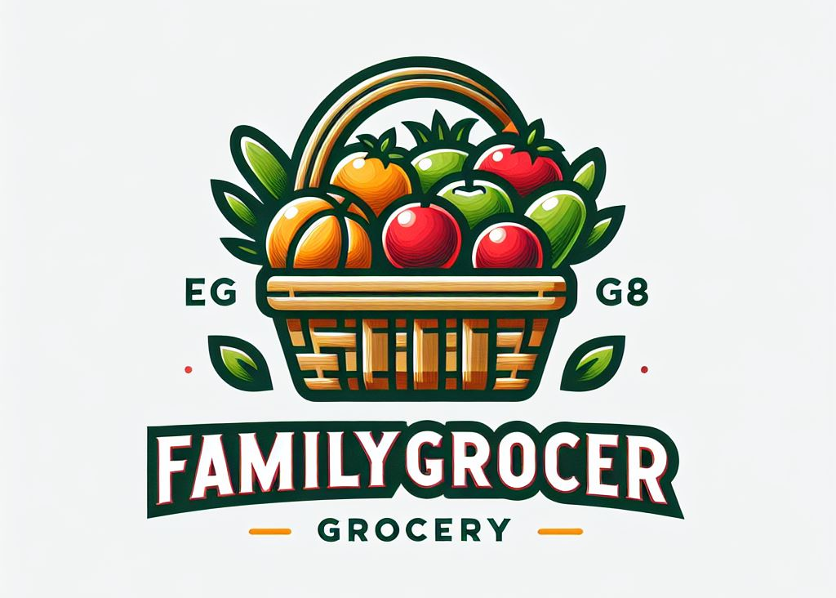
STRATEGIC & OPERATIONAL ROADMAP: 2026
FAMILYGROCER INC.
Q1:
Terminate Salesforce
Governance & Risk Framework
Cloud Readiness
Desktop Software Vendor Agreement
Q2:
Pharmacy Acquisition
Vendor Management Program
Social Media Campaign (pilot)
Improve Security Controls
Q3:
Launch E-Commerce (web grocery)
IoT Inventory Project
Change Management Program
Complete SAP Deployment
Q4:
Social Media Full Scale
Drone Delivery Pilot
KRI/KPI/Compliance Monitoring
Training & Awareness Campaign
BEYOND:
Auditing
Ongoing Training & Awareness
Continuous Improvement
00
01
02
03
04
05
06
07
08
09
10
11
12
Dec
Jan
Feb
Mar
Apr
May
Jun
Jul
Aug
Sep
Oct
Now
Dec
Start
Q1
Q2
Q3
Q4

Slide 17
thank you!

